Slide 1
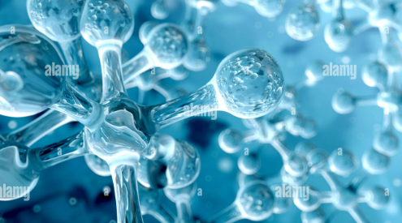
Atomic Theories, Particle Physics &Standard model
Amna Muskan
25-F CY-109

Slide 2
Introduction:
Physics helps us understand matter and energy.
Atomic theory explains the structure of atoms.
Particle physics studies matter at the smallest scale.
The Standard Model combines these ideas.

Slide 3
What Is An Atom?
An atom is the smallest unit of an element.
Atoms form molecules and compounds.
All matter is made from atoms.

Slide 4
Early History Of Atomic Idea(400 BC)
Proposed by Democritus.
Matter is made of tiny indivisible particles.
These particles were called atomos.

Slide 5
Dalton’s Atomic Theory(1803)
Given by John Dalton.
Matter consists of atoms.
Atoms of different elements are different.
Atoms combine in fixed ratios.

Slide 6
Discovery Of Electron(1897)
Discovered by J.J. Thomson.
Showed atoms are divisible.
Electron carries negative charge.

Slide 7
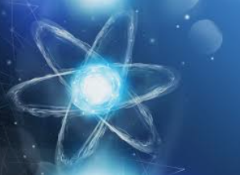
Thomson’s Atomic Model:
Atom is a positively charged sphere.
Electrons are embedded inside.
Known as the Plum Pudding Model.

Slide 8
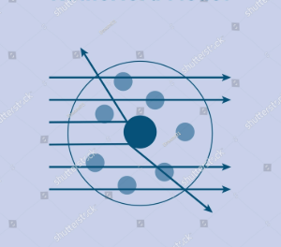
Rutherford’s Atomic Model:
Discovered the nucleus.
Atom has a dense, positive center.
Most of the atom is empty space.

Slide 9
Bohr’s Atomic Model:
Electrons move in fixed circular orbits.
Each orbit has a fixed energy.
Explains atomic spectra.

Slide 10
Mathematical Formula:
Energy of electron in hydrogen atom:
Eₙ = −13.6 / n² (eV)
n = principal quantum number

Slide 11
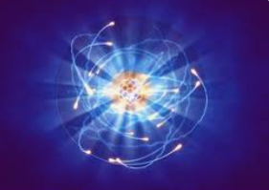
Quantum Mechanical Model:
Proposed by Schrodinger & Heisenberg.
Electrons behave like waves.
Position is described by probability.

Slide 12
Applications Of Atomic Theory:
Chemical bonding and reactions.
Nuclear energy production.
Medical uses like X-rays and MRI.

Slide 13
Introduction To Particle Physics:
Branch of physics studying subatomic particles.
Explains matter, forces, and energy.
Also called high-energy physics.

Slide 14
History Of Particle Physics:
1897: Electron discovered.
1932: Neutron discovered.
20th century: Many particles identified.

Slide 15
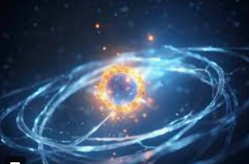
Fundamental Particles:
Matter particles (fermions).
Force-carrying particles (bosons).
These particles form the universe.

Slide 16
Matter Particles:
Quarks: up, down, charm, strange, top, bottom.
Leptons: electron, muon, tau, neutrinos.

Slide 17
Force Particles:
Photon – electromagnetic force.
Gluon – strong force.
W and Z bosons – weak force.

Slide 18
Mathematical Formula:
Einstein’s mass–energy relation:
E = mc²
Shows mass can be converted into energy.

Slide 19
Applications Of Particle Physics:
Particle accelerators (CERN).
Cancer treatment (radiation therapy).
Electronics and modern technology.

Slide 20

Introduction To Standard Model:
A theory explaining fundamental particles.
Describes three basic forces.
Gravity is not included.

Slide 21
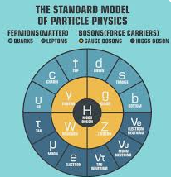
Components Of Standard Model:
Quarks
Leptons
Gauge Bosons
Higgs Boson

Slide 22
History Of Standard Model:
1960s: Quark theory proposed.
1970s: Electroweak theory developed.
2012: Higgs boson discovered.

Slide 23
Applications Of Standard Model:
Explains nuclear reactions.
Helps in advanced scientific research.
Used in particle accelerators.

Slide 24
Mathematical Formula:
The standard model is explained using a main eqution called lagrangian:
LSM=Gauge terms+ Matter terms+ Higgs terms
It is based on the symmetry:
SU(3)c x SU(2)l x SU(1)y

Slide 25
Overall Summary:
Atomic theory explains atom structure.
Particle physics studies smaller particles.
Standard Model unifies modern physics.

